Slide 1
Celestia
A business data visualisation software
2329 Sanket Mhamal
2330 Vinay Mirajkar

Slide 2

Introduction
Celestia is a, Hardware Inventory, System with built in data visualisation tools.
In the dynamic and fast-paced environment of a hardware store, efficient management of inventory is crucial for maintaining optimal operations and customer satisfaction. A well-designed Hardware Store Inventory Management System provides a comprehensive solution to streamline inventory control, reduce costs, and enhance decision-making processes.
This system not only ensures that the hardware store is well-stocked with the necessary items but also leverages the power of data visualization to provide valuable insights on a day-to-day basis.

Slide 3
Approach
This system was initially planned to be able accommodate all business systems, and work with all business related systems. But due to limitation of time as well as resources such as the data required to understand the techniques to visualise this data, we reduced the scope of the project to a single system.
We did this by contacting local shops seeing if they were in need of one.
A new upcoming shop called John’s hardware shop opening next year in Arpora,Goa needed a inventory management system that would dynamically update its inventory and display results.

Slide 4
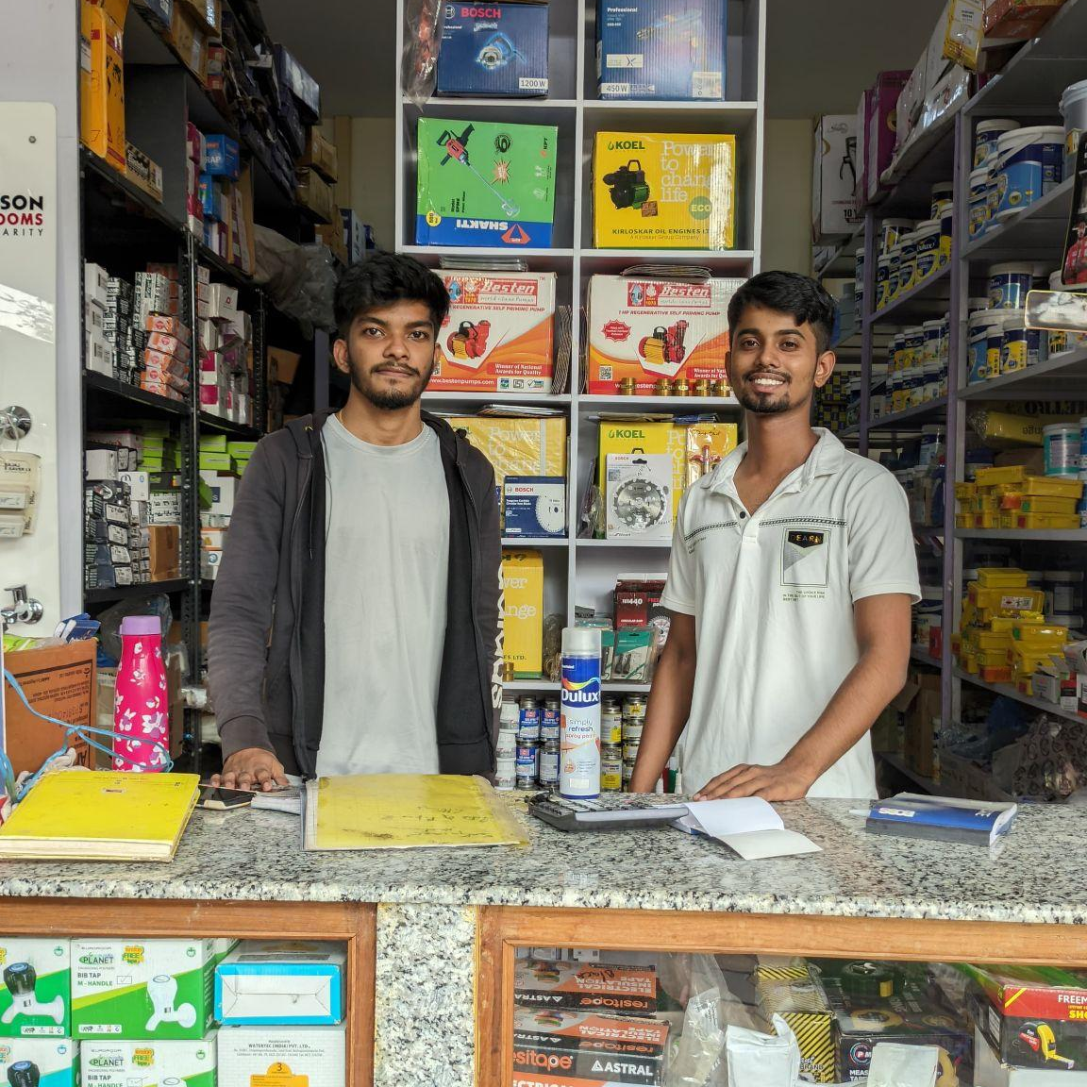
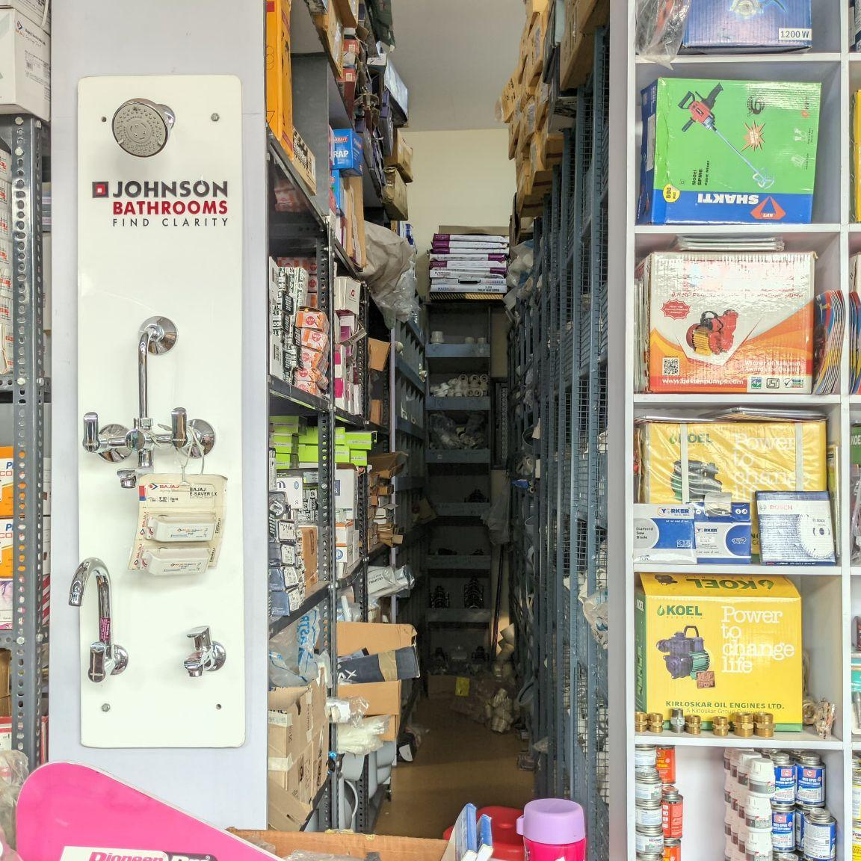
Requirement Analysis
Before we moved to analysing data, we needed… well data!
To understand the needs, and required features of a hardware inventory management system. We visited many different hardware stores to understand the inner workings of a store.
What kind of data they store?
What are the current systems used to keep track of inventory?
What are insights required for business?

Slide 5
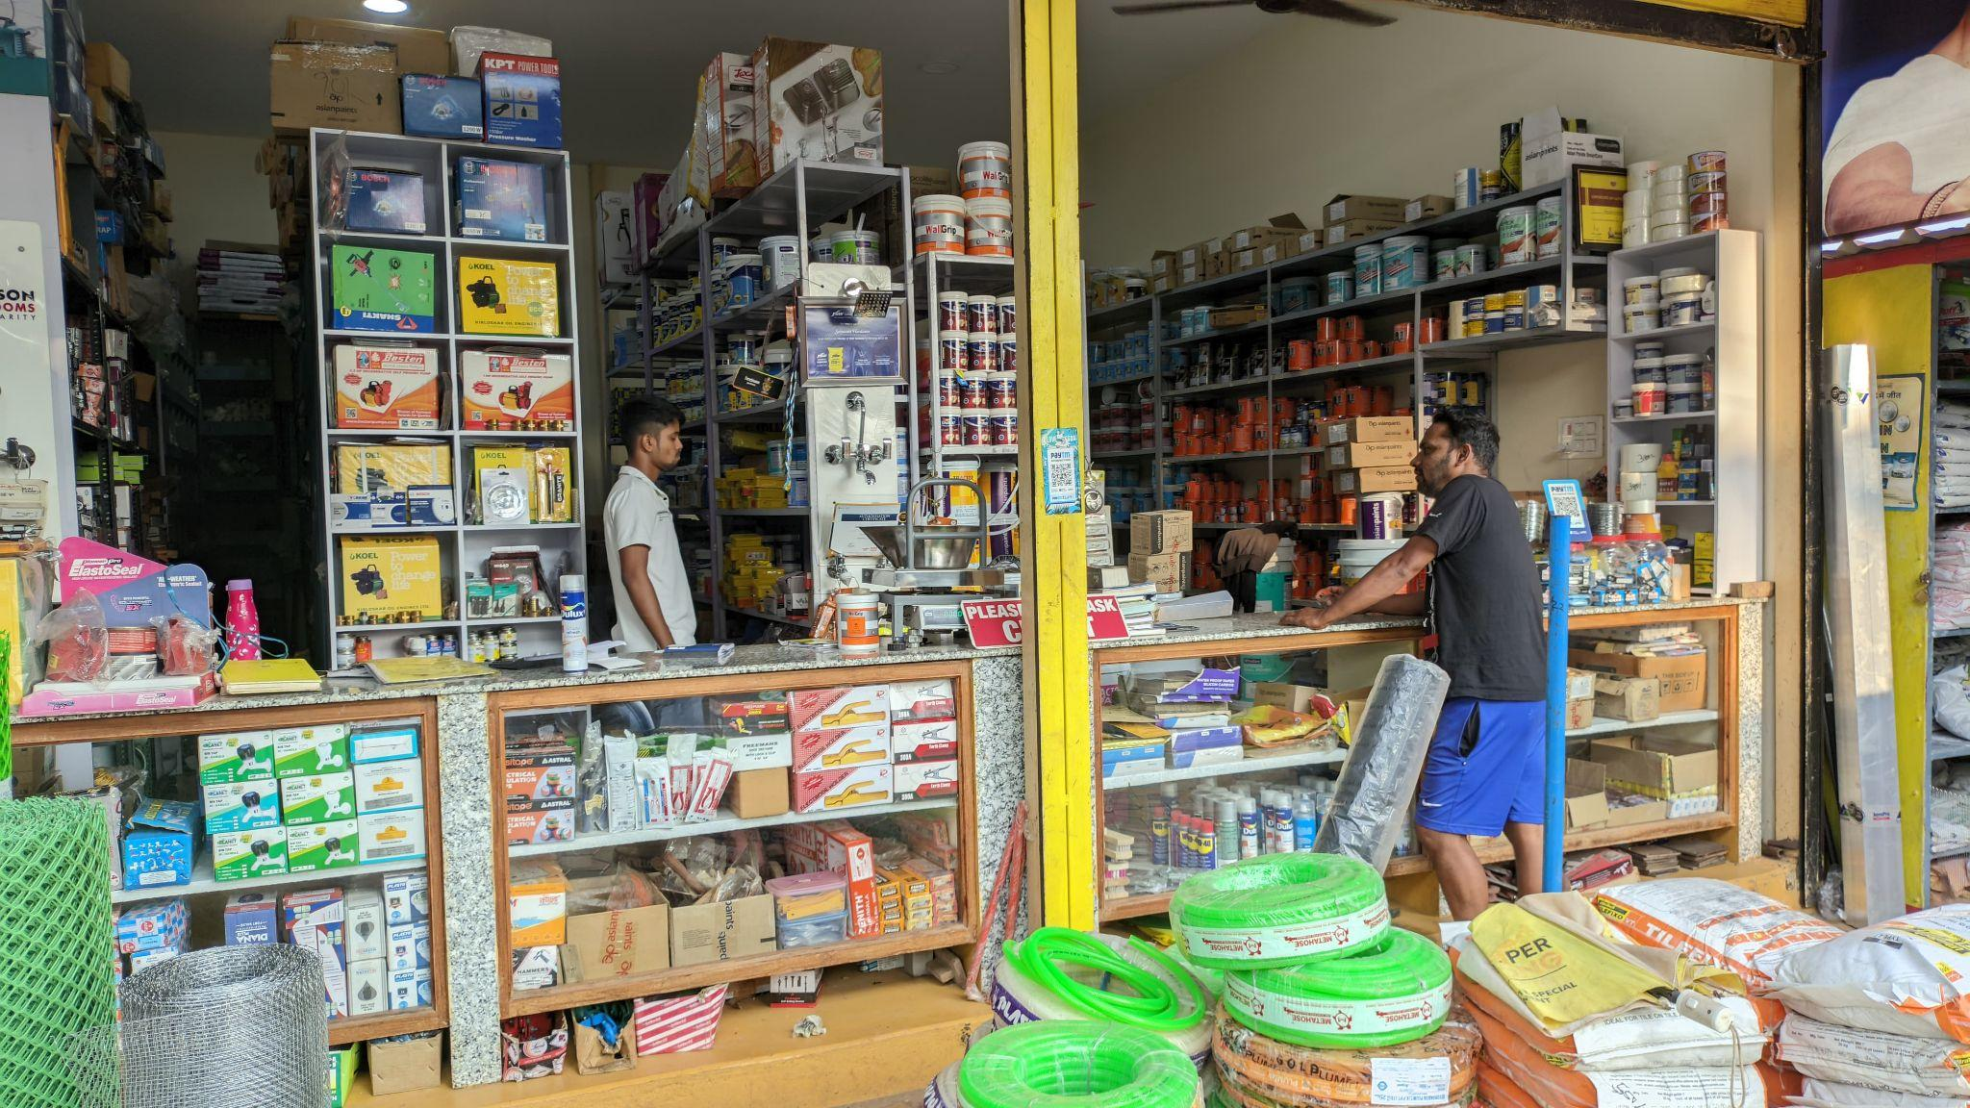
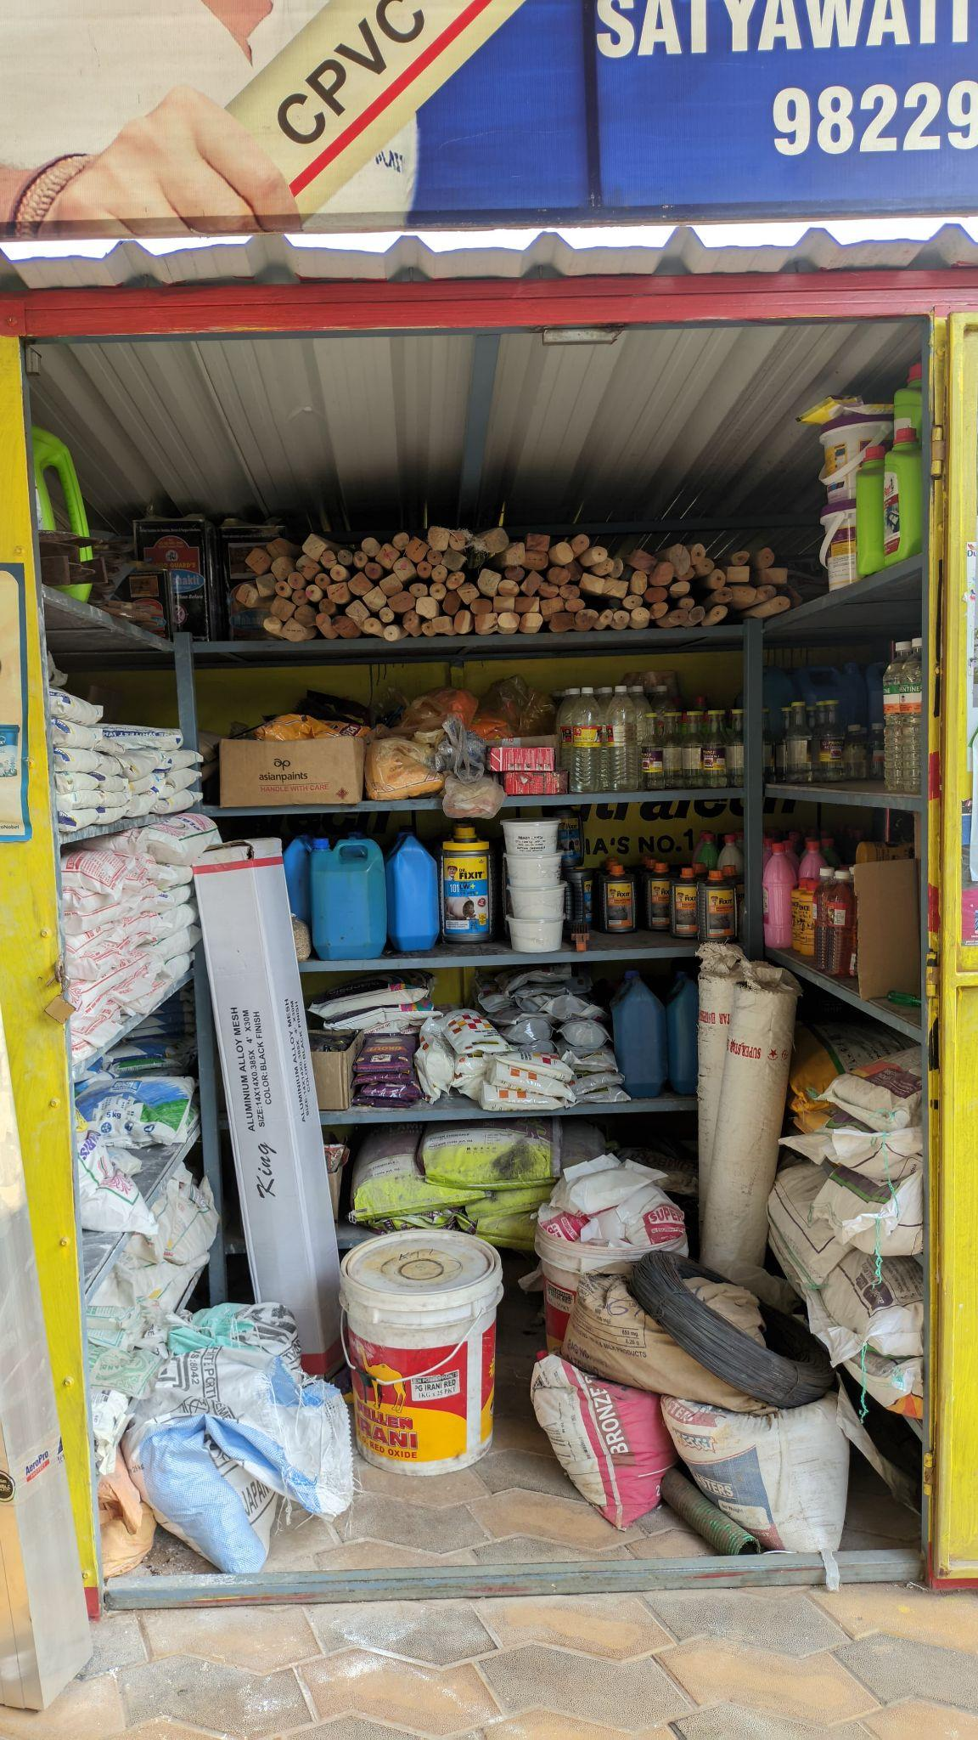
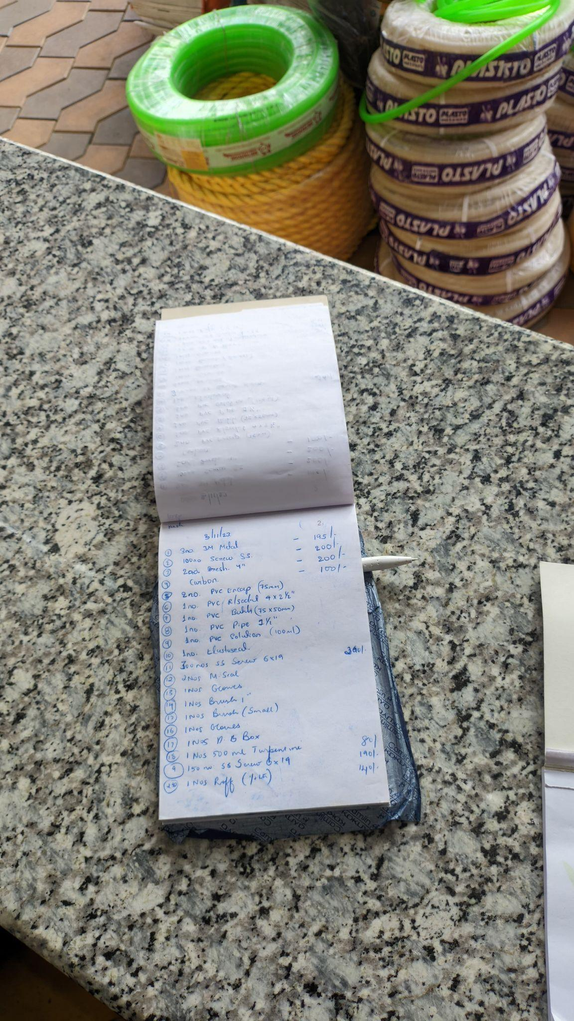
Requirement Analysis
What we found was
Most stores kept data, in handwritten format.
A few stores used excel based systems to store data.
A few bigger stores had Inventory Management Systems, but they lacked any visualisation tools.
They required data like, date of sale, names of item, cost, quantity,

Slide 6
Features:
The system has 2 parts
Hardware management system.
Allows multiple users, with login and authentication
An inventory management system that keeps track of products, customers and orders/sales.
Has a billing system, with printable bills that also keeps track of orders.
Users the Java Db (derby) database to store data.
Data Visualisation System
Generates insights using various data visualisation tools such as bar graphs,histograms, pie charts,box plot scatter plot etc.
Uses jtablesaw, in order to implement the python plotly library to work on data.
Option to convert the database entries to csv files which may be used with excel if required.

Slide 7
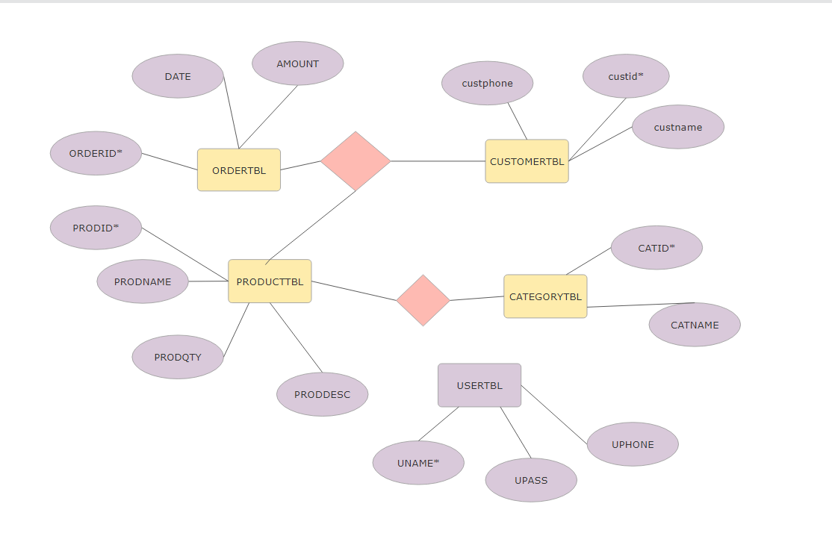
ER Diagram

Slide 8
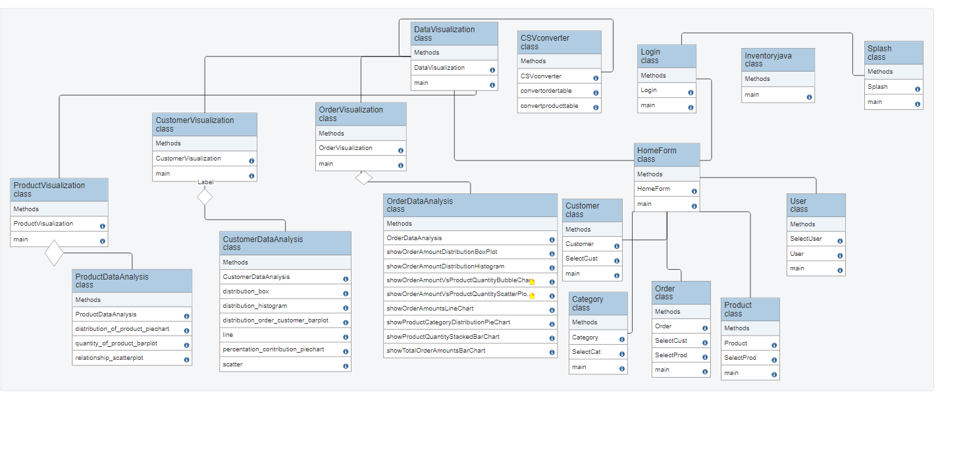
Class Diagram

Slide 9
Technologies used
Derby: Apache Derby is a lightweight, open-source relational database management system (RDBMS) implemented entirely in Java.
JTablesaw: JTablesaw is a Java data manipulation library, providing DataFrame functionality for data analysis and visualization.
Log4j: Log4j is a widely-used Java-based logging utility that provides flexible and configurable logging services for applications.
Swing: Swing is a set of GUI components for Java applications, offering a rich and platform-independent framework for building graphical user interfaces.
Apache NetBeans: Apache NetBeans is an open-source integrated development environment (IDE) for Java, providing tools for application development, debugging, and project management.
rs2xml: rs2xml is a library for converting JDBC ResultSet data into XML format, facilitating seamless integration of database results into Java applications.

Slide 10
Implementation
Hardware Inventory Management
Uses JavaDB derby database to store data.
Takes user input for products, product categories,customer details etc and stores, through Product, Category,Customer classes.
Allows to do edit,add,delete functionalities for above as well as display previous entries from database
Processes and stores order details, generates a bill for the purchases of given user through the Order class.Once order is placed updates all tables.
Can make and manage users, who can login and use the system, through User Class.
Authentication done in the Login class.

Slide 11
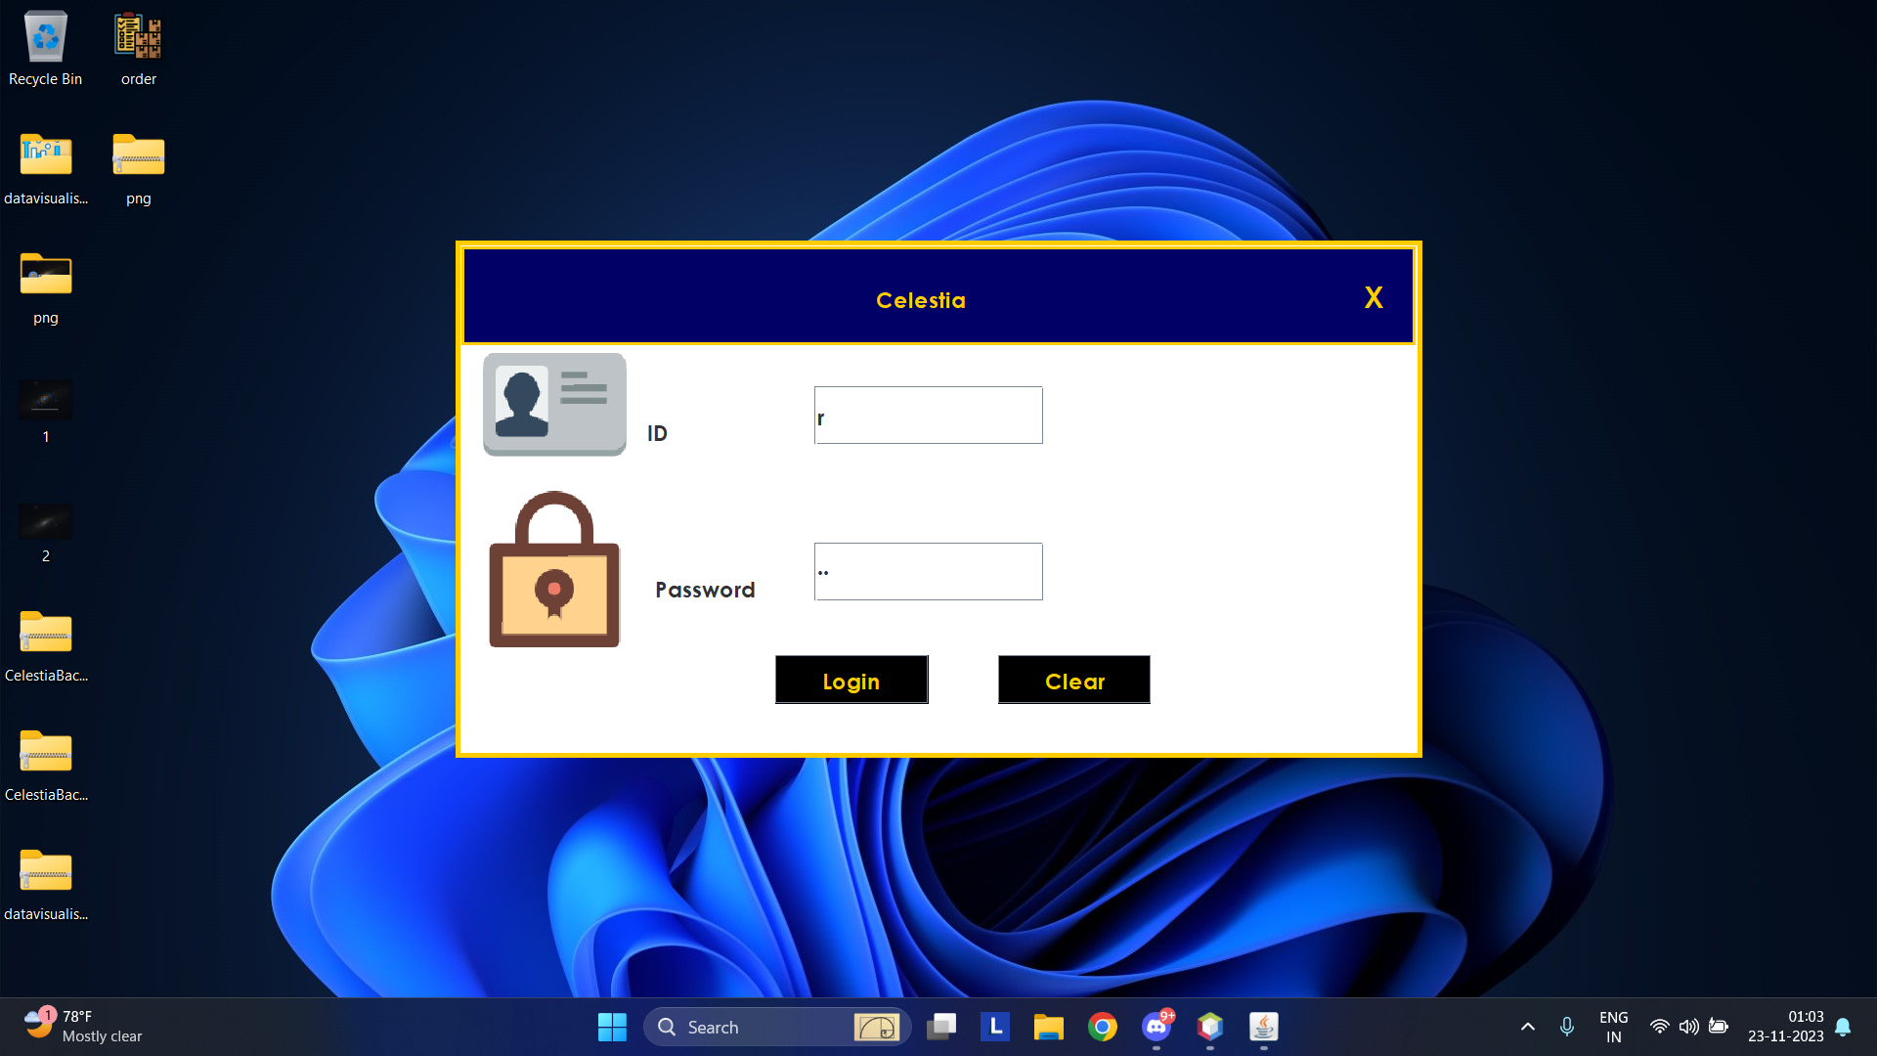
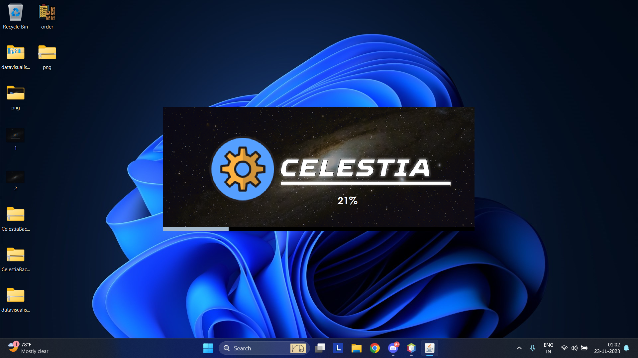
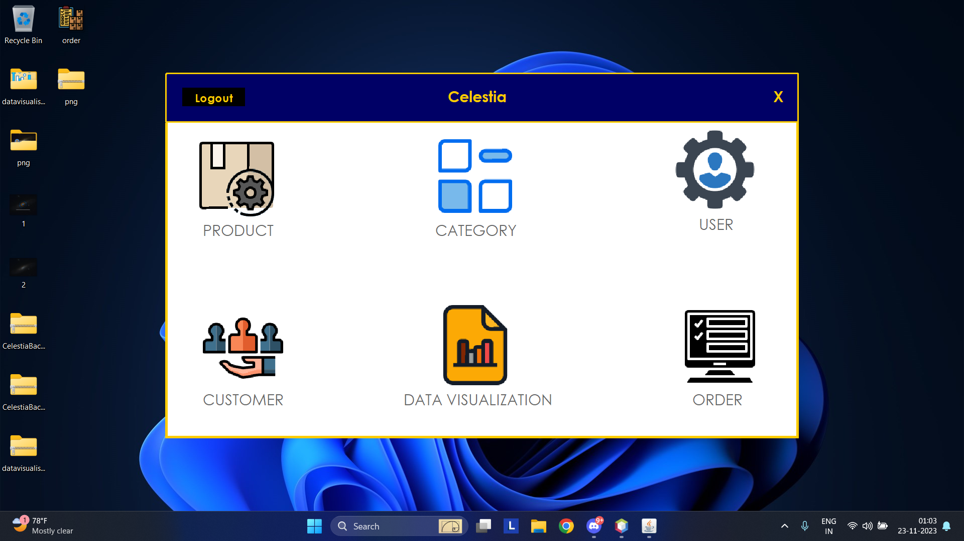
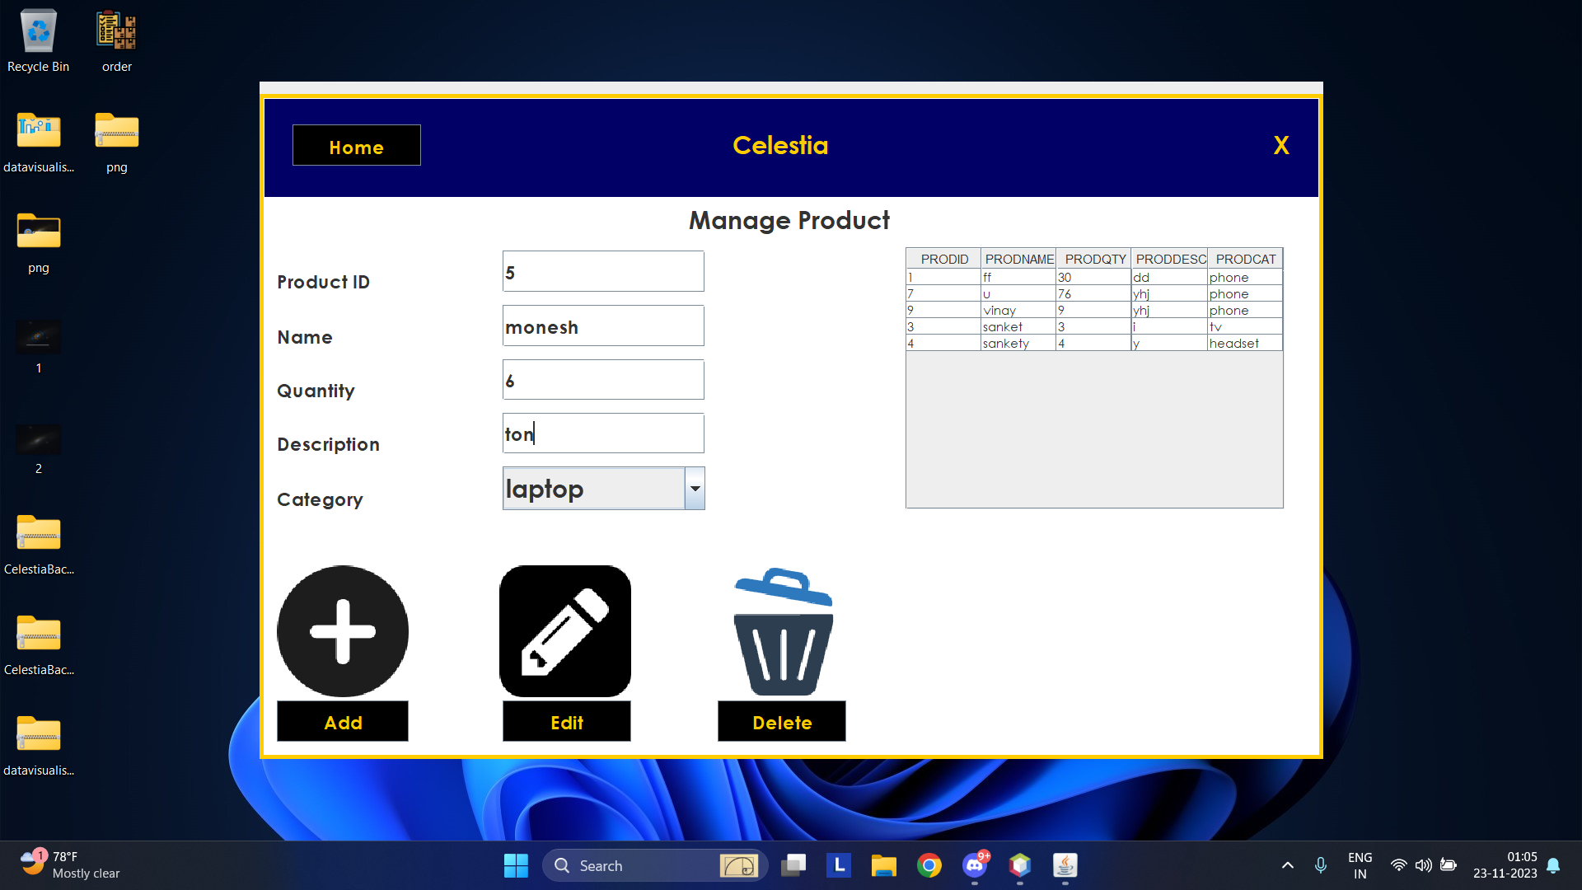

Slide 12
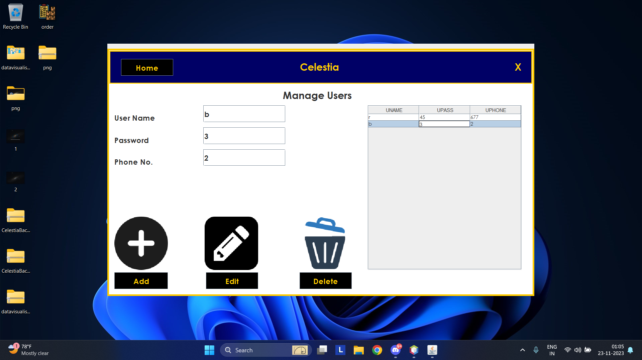
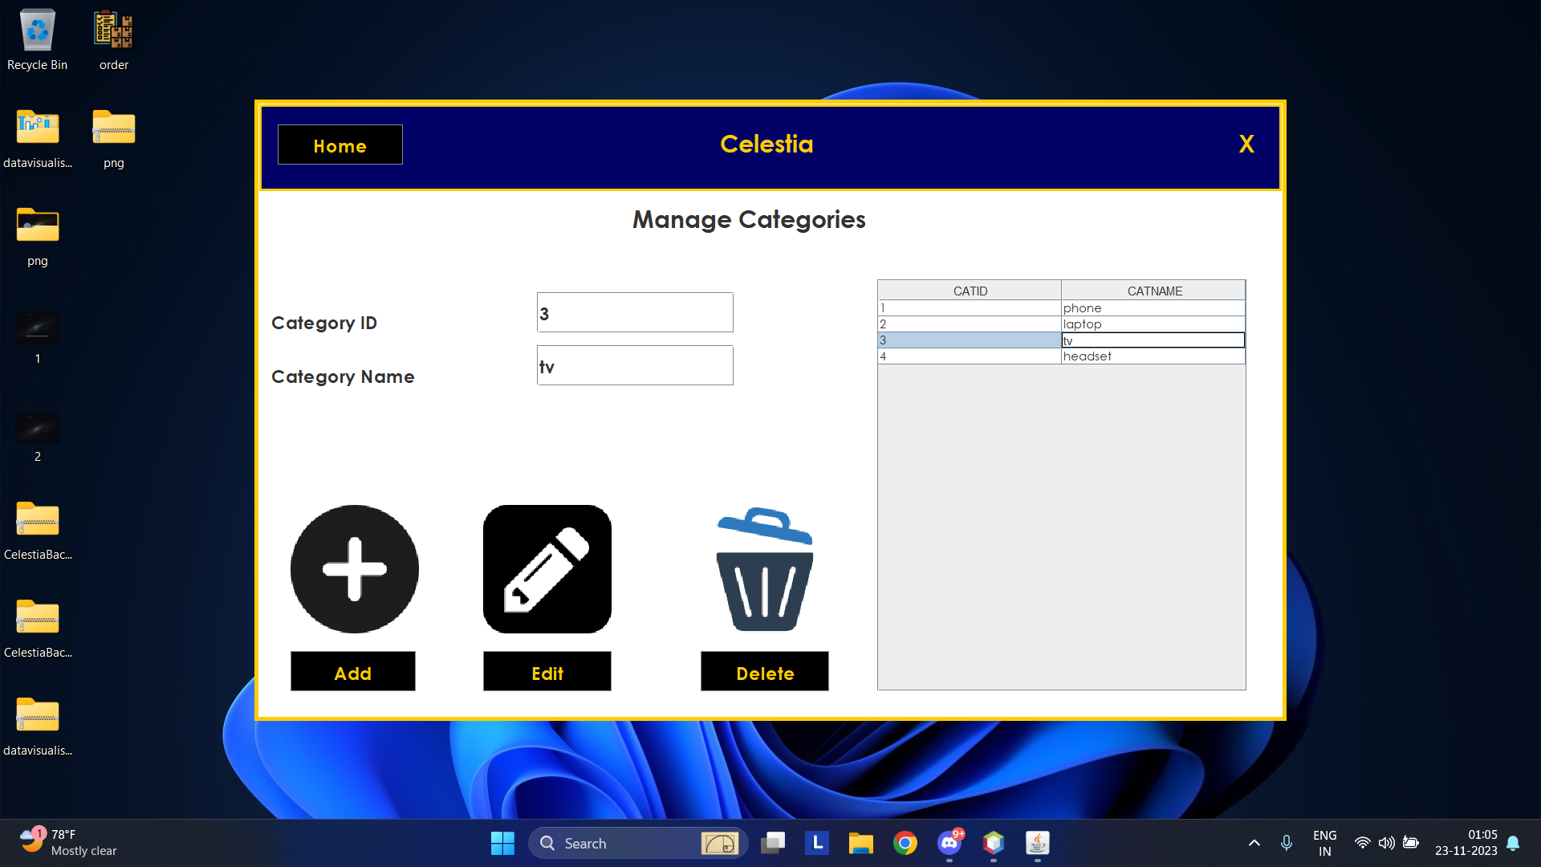
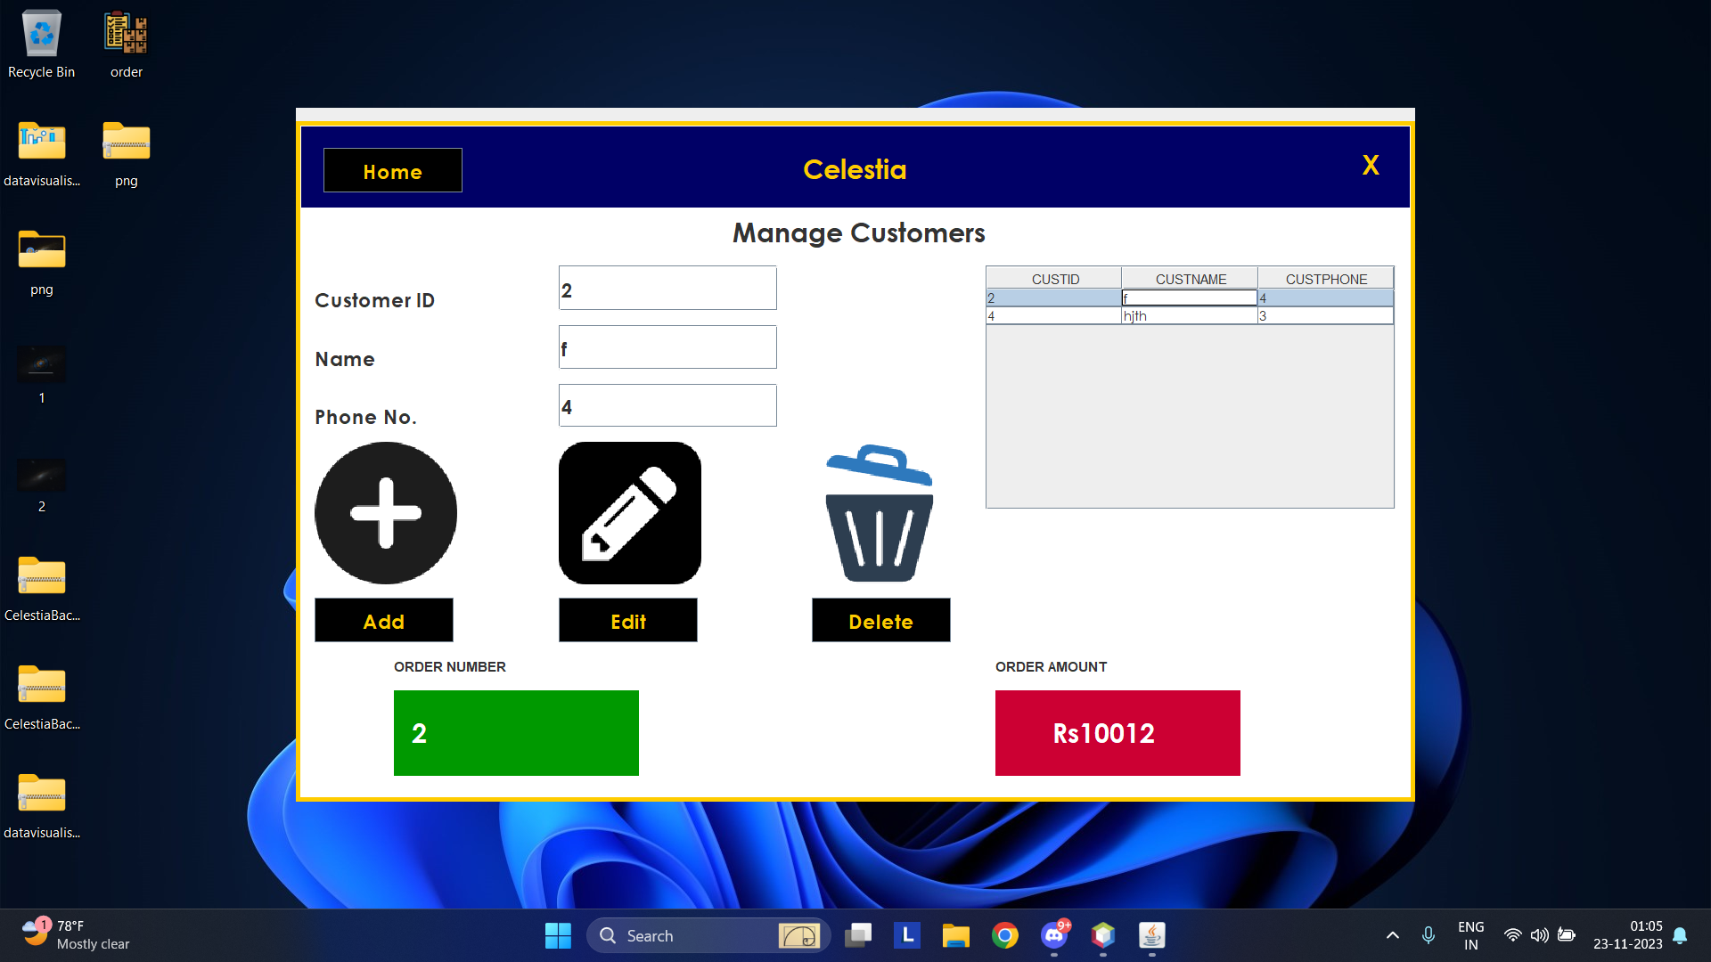

Slide 13
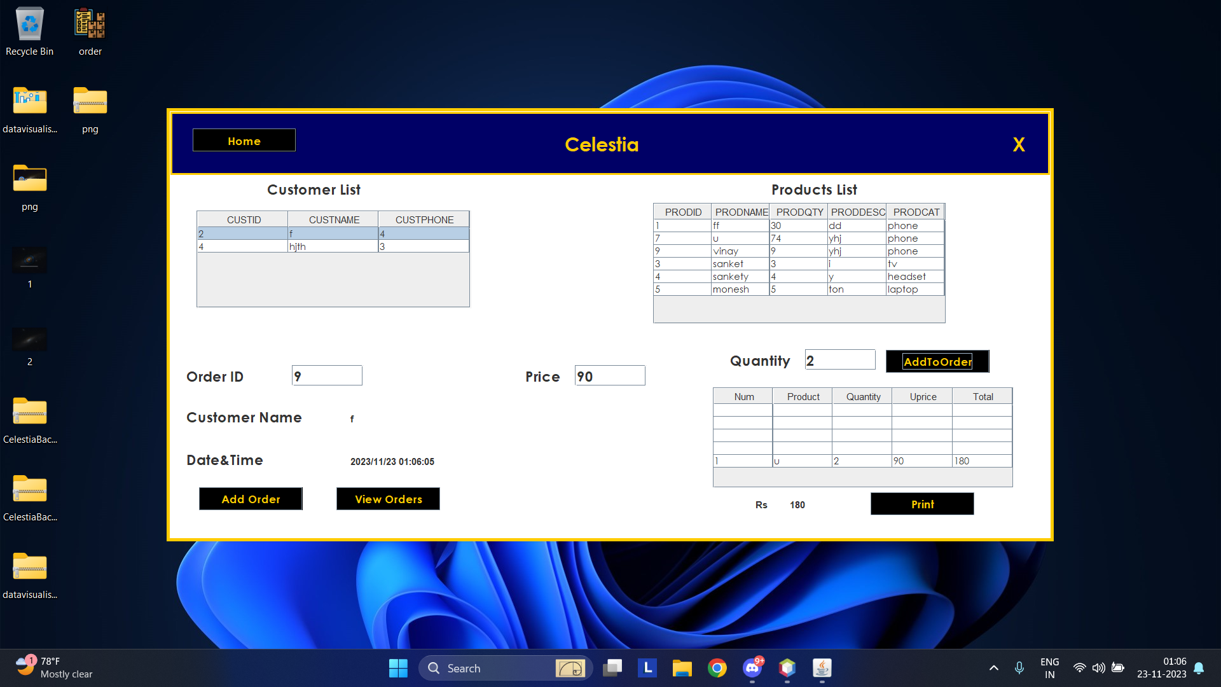
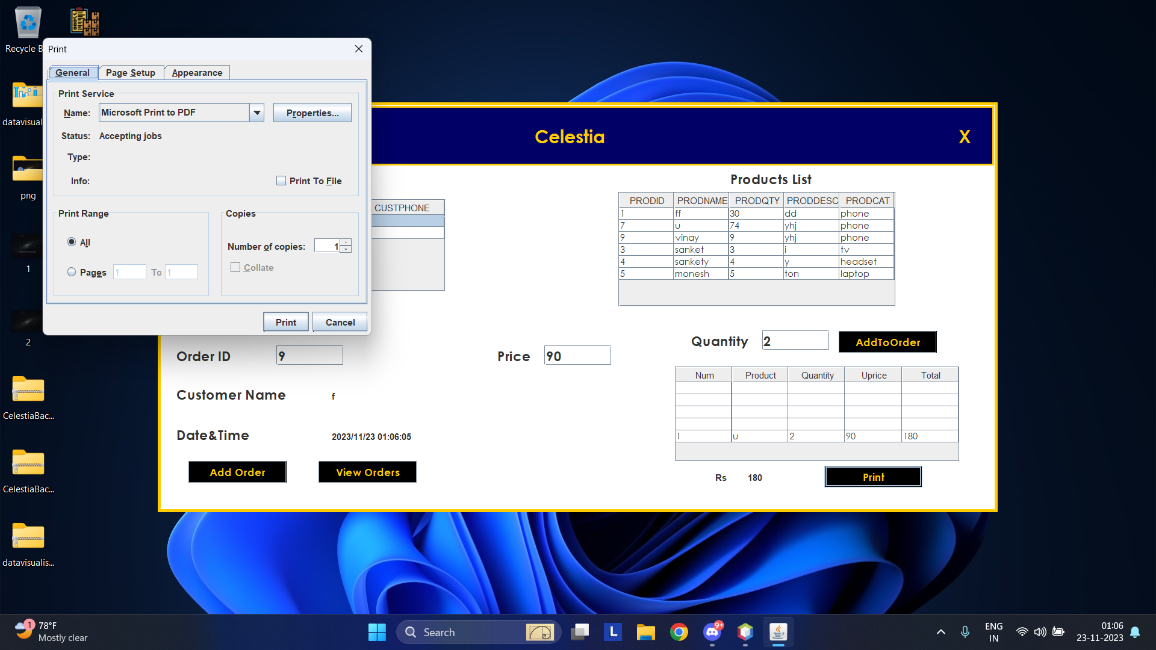

Slide 14
Data visualisation system
Uses jtablesaw, in order to implement the python plotly library to work on data and generate valuable insites.
Data taken from database and converted into csv format using CSVconverter class.
The generated graphs can be grouped into 3 broad categories. Based on product data, based on customer data and based on order data.
The graphs are generated as html pages.
The graphs once generated maybe edited in the file itself.

Slide 15
Types of Graphs
Bar Chart: Quantity of each product
Pie Chart: Distribution of product categories based on total quantities
Histogram: Distribution of order amounts for all customers
Box Plot: Distribution of order amounts for each customer
Line Chart: Trend of order amounts over time for each customer
Scatter Plot: Relationship between the number of orders placed by a customer and the total order amount
Percentage contribution of each customer to the total order amount
Distribution of order amounts for each customer
Line Chart:Order Amounts Over Time
And more

Slide 16
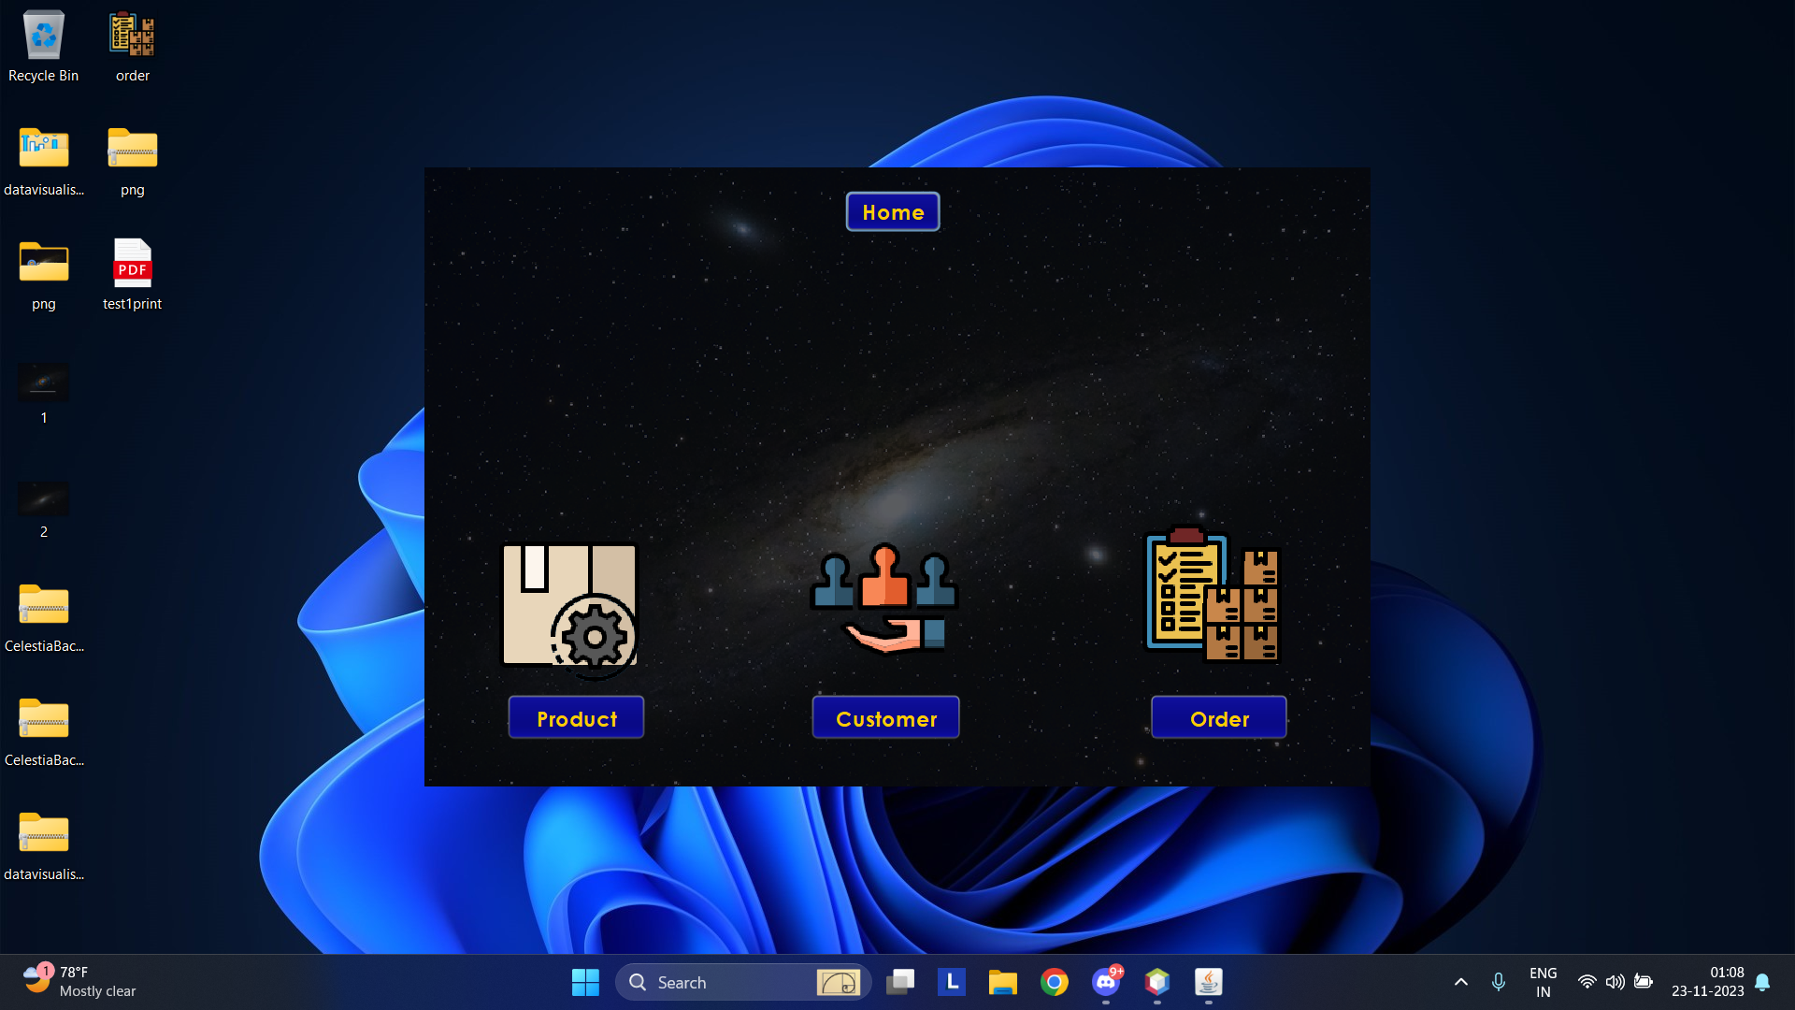
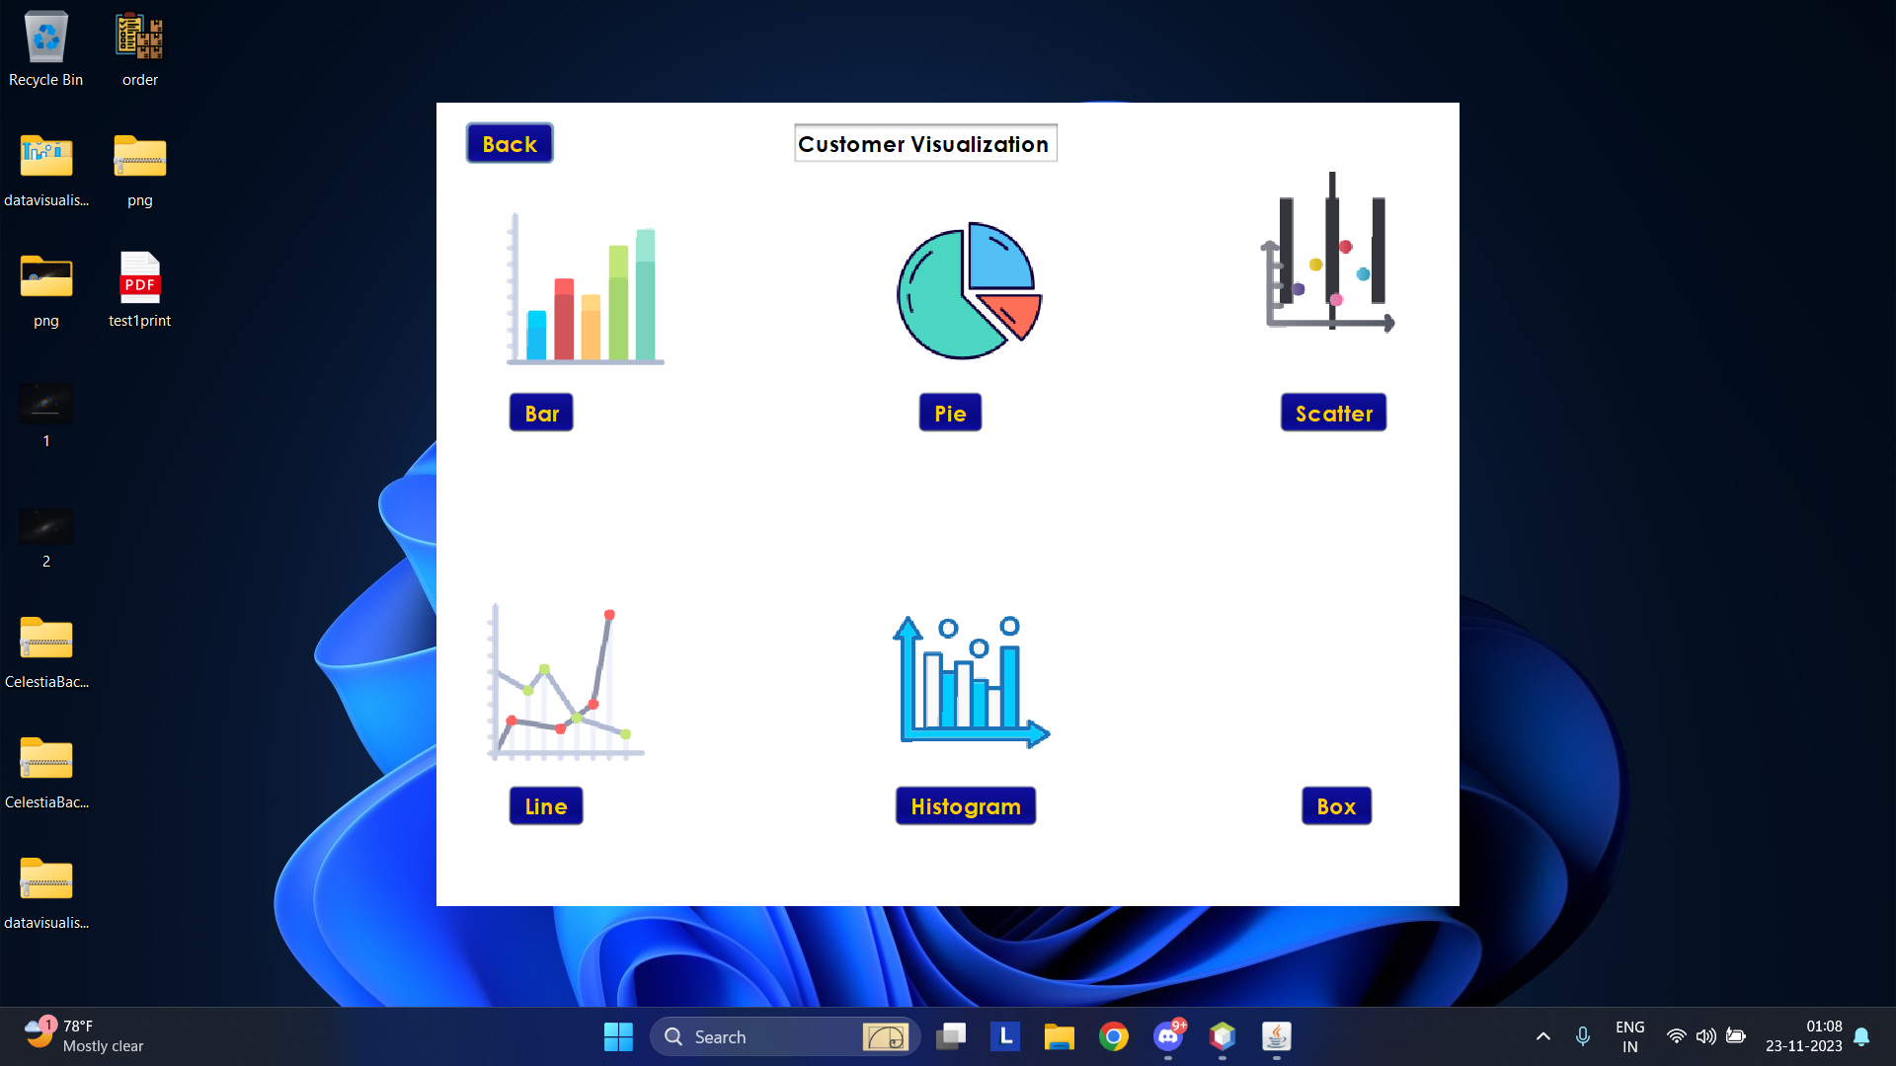
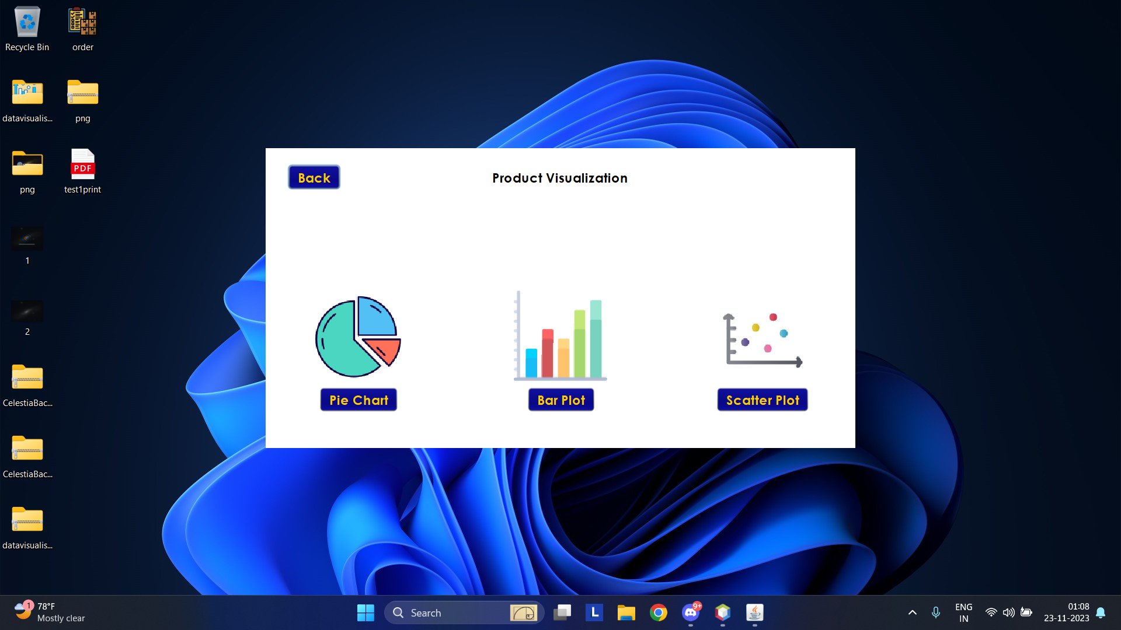
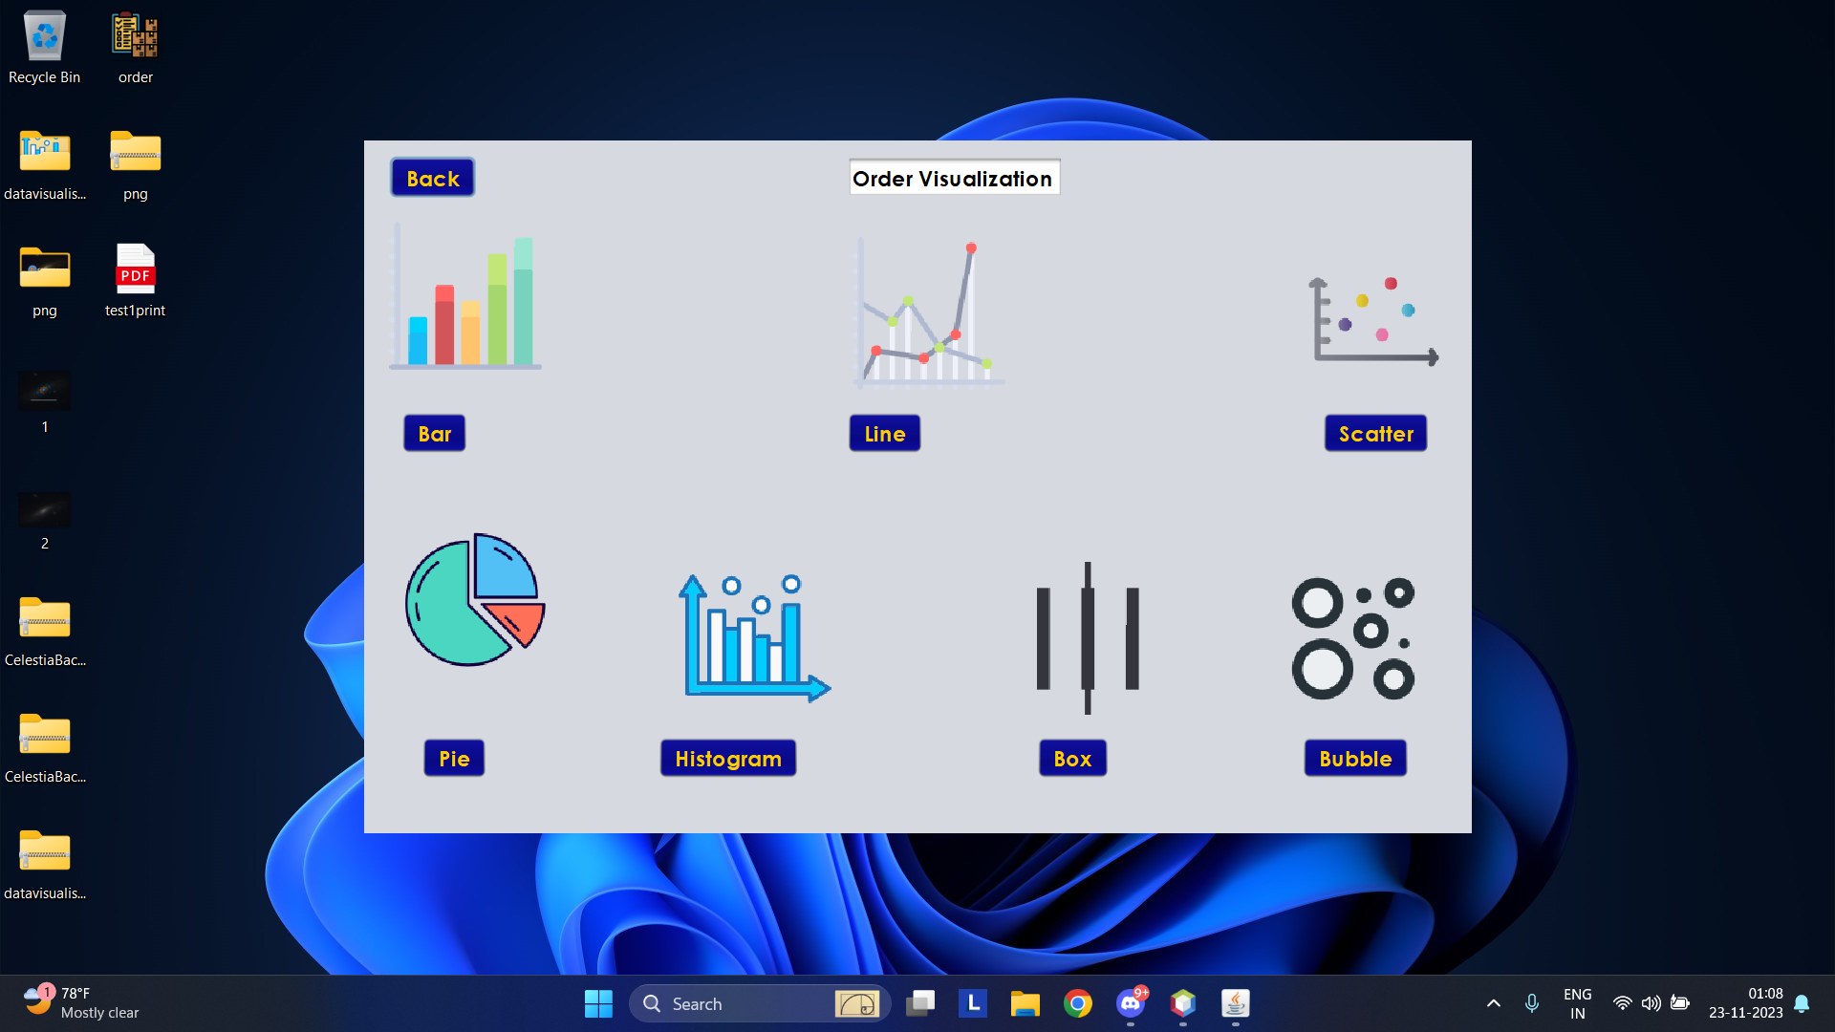

Slide 17
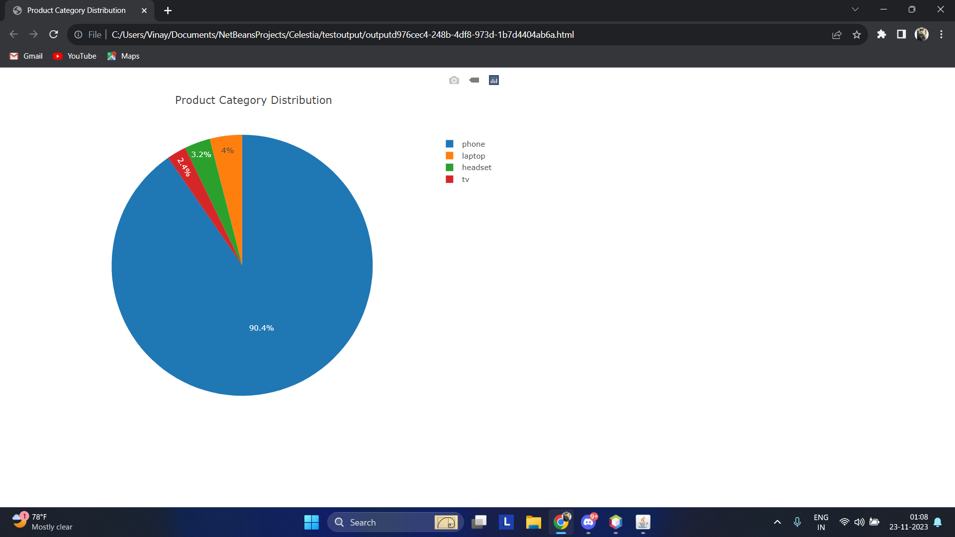
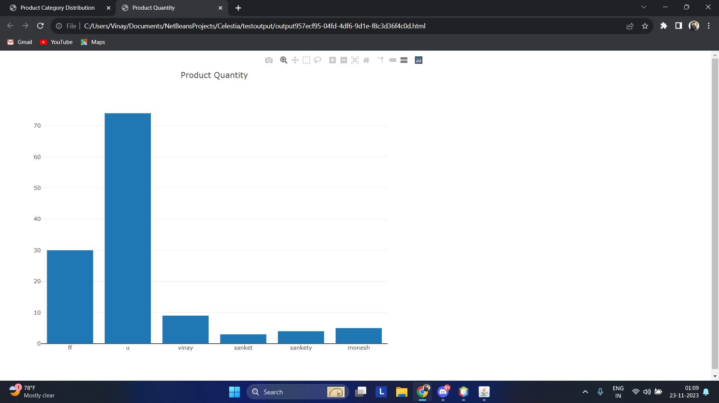
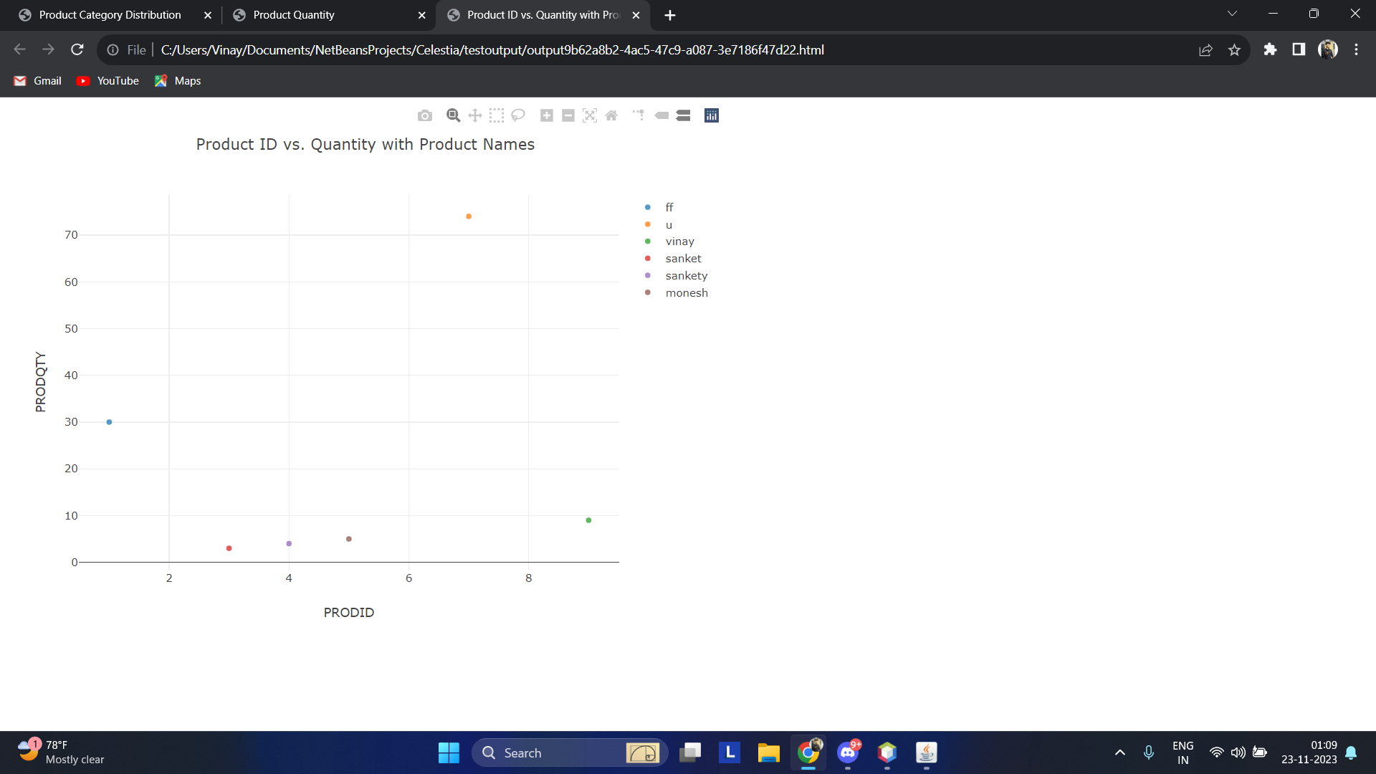
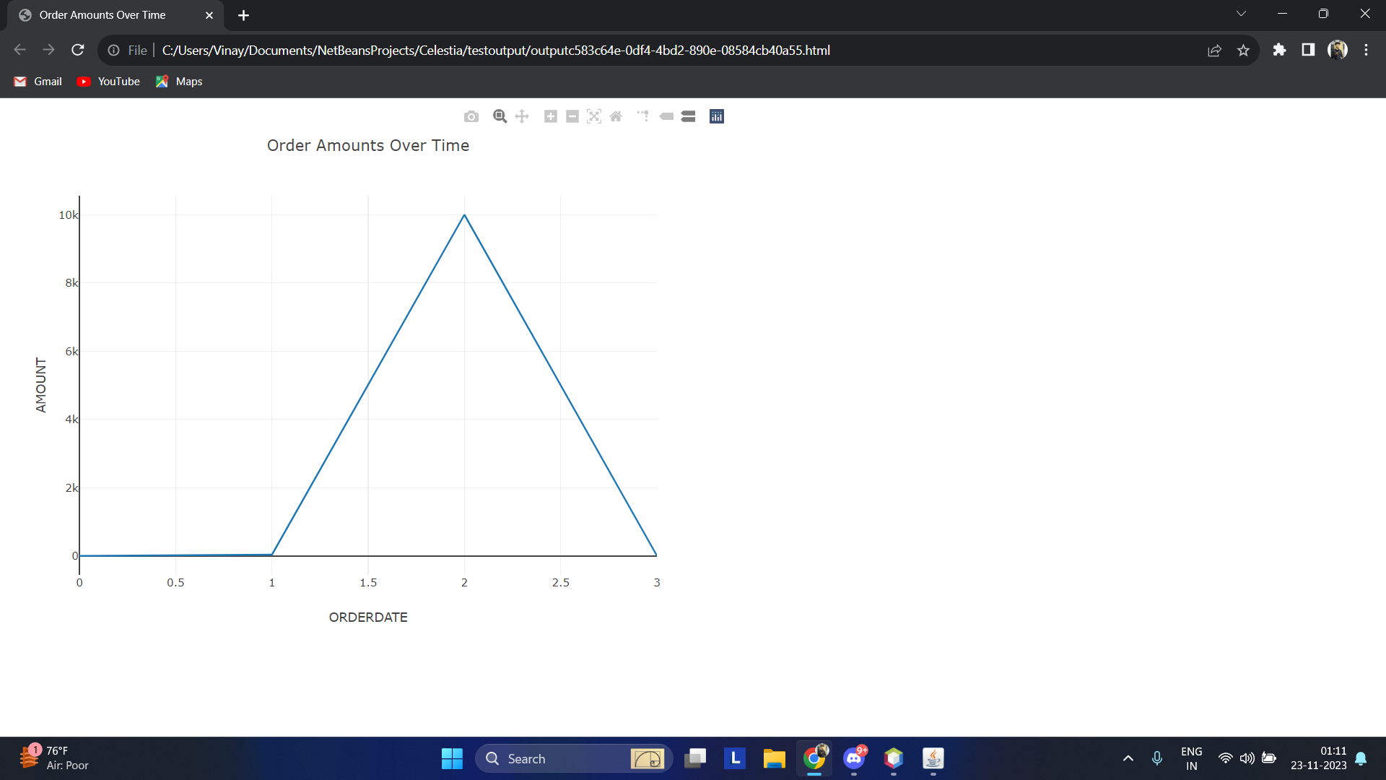

Slide 18
Limitations and future scope
Limitation /future scope
The visualisation were done based on our assumptions and knowledge so the insights generated may not be useful to all hardware stores that may use this software.
The visualisation is done currently as html pages and is not directly within app, if we can host this we may be able to directly display the webpages.

Slide 19
Benefits
Efficient Inventory Management: Streamlined tracking and management of inventory in real-time, reducing the likelihood of stockouts or overstock situations.
Cost Reduction: Automation of procurement processes and accurate tracking minimize errors, leading to cost savings and optimal resource allocation.
Improved Decision-Making: Data visualization provides actionable insights, empowering stakeholders to make informed decisions based on trends, patterns, and key performance indicators.
Enhanced Customer Service: Proactive stockout alerts prevent disruptions, ensuring a consistent and uninterrupted customer shopping experience.
Supplier Relationship Enhancement: Efficient communication with suppliers improves relationships, leading to better negotiation terms, product quality, and overall supply chain efficiency.
Time Savings: Automation of repetitive tasks and streamlined processes save time, allowing staff to focus on more strategic and customer-oriented activities.

Slide 20

Thank you

